Slide 1

PERFORMANCE PREDICTION FROM GAME PLAY
SC1015 MINI-PROJECT
Notes:
Greetings Professionals and TAs.
We're from SC1015 B124 Group 2.
In this recorded presentation, My team will be sharing our finding on the performance prediction from game play.

Slide 2
INTRODUCTION
PREPARATION
ANALYSIS
CONCLUSION
Problem definition ; Dataset Context ; Objective
Exploratory Data Analysis (EDA) ; Preprocessing
Machine Learning Models formulation & analysis
Outcome ; Limitation
Notes:
We'll start off with the introduction
Followed by, the preparation of the data before going into machine learning models formulation and analysis.
Lastly, we'll end off with the conclusion

Slide 3
INTRODUCTION
01
Problem Definition
Dataset Context
Objective
Notes:
Starting with Introduction

Slide 4
PROBLEM DEFINITION
Short attention span
Children exposure to a wide variety of media & technology in today’s digital age
Lack of interest & motivation
Many students do not have interest and struggle with motivation, particularly in subjects that they find difficult or uninteresting
Achievement gap
There is a persistent achievement gap in education, particularly among students from disadvantaged backgrounds
Need for 21st-century skills
The modern workforce requires a range of 21st-century skills, such as problem-solving, critical thinking, and collaboration, which cannot be simply taught through textbooks
Notes:
In today's digital age, children are exposed to a wide variety of media and technology, which has led to shorter attention spans.
Many students struggle with motivation which can result in a lack of progress and can negatively impact their overall academic performance.
There is a persistent achievement gap in education, particularly among students from disadvantaged backgrounds, which can limit their opportunities and hinder their ability to succeed.
However, game-based learning can help to address these challenges.
By providing an immersive and engaging learning experience, and provide a sense of achievement, which can be a powerful motivator for students.
Furthermore, game-based learning can help to level the playing field by providing an accessible and interactive learning experience for all students, regardless of their background.
Lastly, game-based learning can help to develop essential 21st-century skills, such as problem-solving, critical thinking, and collaboration, which are increasingly valued in the modern workforce.

Slide 5
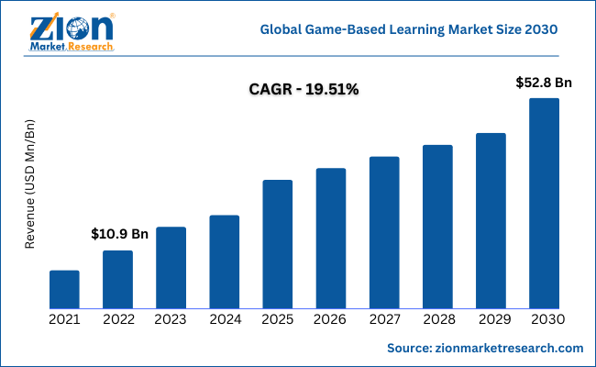
The use of game-based learning has increased in recent years, as educators recognize the benefits of using games as a tool for teaching and learning
Notes:
As educators continue to explore new and innovative ways to engage students in the learning process, game-based learning has emerged as a popular and effective tool.
According to Zion Market Research, Game-based learning is projected to grow rapidly in the next few years, with a predicted market size of USD 52.8 billion by 2030, up from USD 10.9 billion in 2022, at a compound annual growth rate of 19.51%.

Slide 6



DATASET
OBJECTIVE
It utilises historical analysis
It access the player’s comprehension skills
To predict player's performance through game play to access the effectiveness of using game-based learning to train one's comprehension skills
Notes:
To address the problem we defined earlier, we decided to use a dataset from an ongoing Kaggle competition.
The dataset was collected from a free online game called Jo Wilder and the Capitol Case, which uses historical analysis to help students develop their reading comprehension skills.
With that, our project aims to use this dataset to predict a player's performance in the game, and to assess the effectiveness of game-based learning as a tool for training comprehension skills.

Slide 7

02
PREPARATION
Exploratory Data Analysis (EDA)
Preprocessing
Notes:
Moving on the the preparation phrase

Slide 8
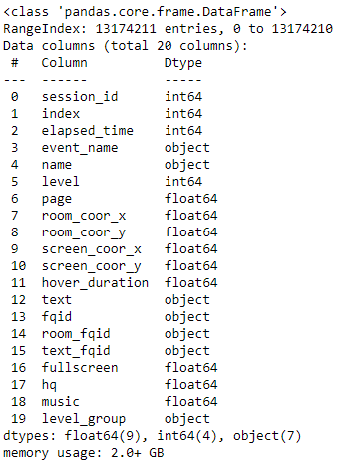
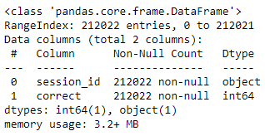
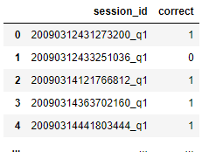
OBSERVATION OF THE DATASET
Predictors : train.csv
Response : train_labels.csv
Format of both files are different
Requires preprocessing to combine both data files
session_id & level
Notes:
The data for our analysis consists of two files: one containing the predictors and the other containing the response data.
The predictor data file is quite large, and may require preprocessing to reduce its size.
Additionally, the format of the response data file is different compared to the predictor's file, which means that both files require preprocessing in order to combine the data for analysis.

Slide 9
Notes:
https://pbswisconsineducation.org/jowilder/about/
IMPORTANT COLUMN EXPLANATION: Here’re meaning of important columns and contents within.
Upon analysing the unique value of each columns and playing the game, the definition of each columns can be understood
Run through the game and annotate the data collected

Slide 10

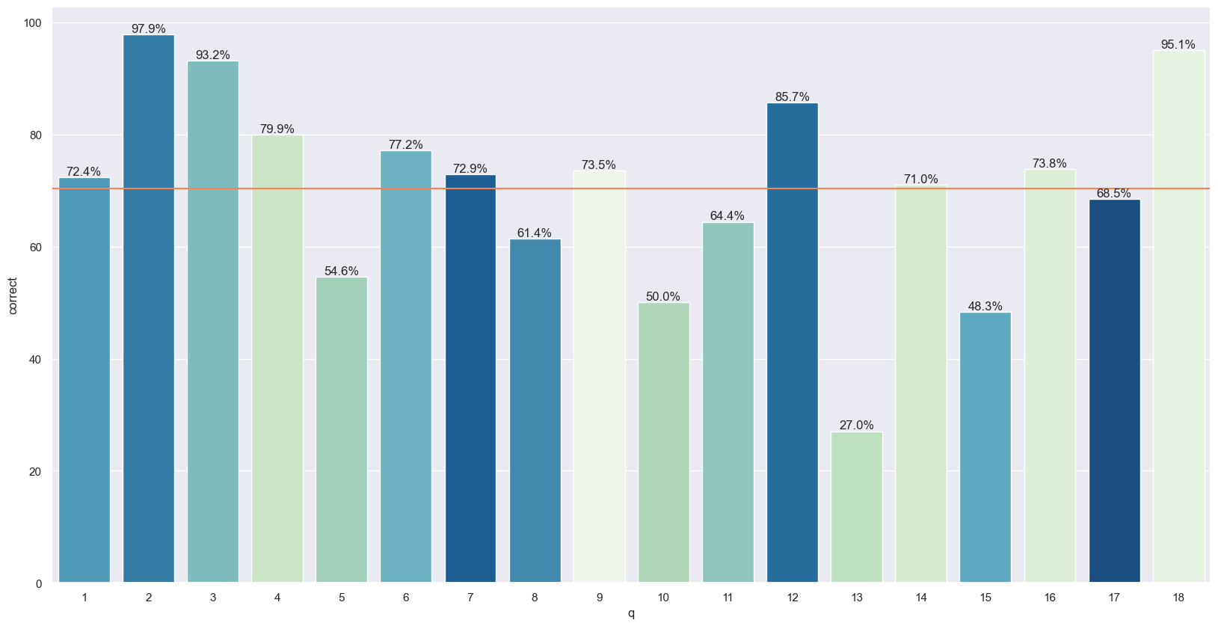
QUESTION-WISE AVERAGE ACCURACY RATE
Question 2, 3, 12 & 18 have relatively better performance
Question 5, 10, 13 & 15 have poorer performance
Notes:
For an overview of the question-wise average accuracy rate, We plotted a graph, with an orange line indicating the average accuracy rate across all the questions.
It also reveals that Question 2, 3, 12, and 18 have relatively better performance than the other questions while Question 5, 10, 13, and 15 have poorer performance compared to the average accuracy rate

Slide 11
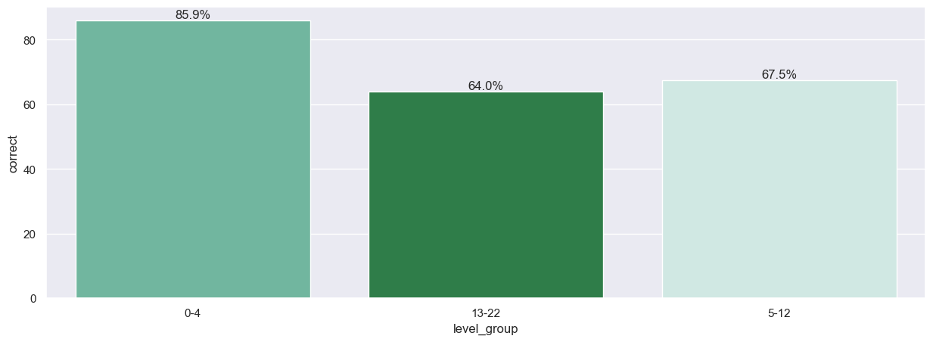
SCENARIO-WISE AVERAGE ACCURACY RATE
Scenario 1 has the best performance
Notes:
In addition, we also examined the scenario-wise average accuracy rate. It shows that the first scenario has the best performance, while the other two scenarios have similar performance.

Slide 12
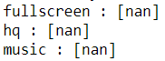
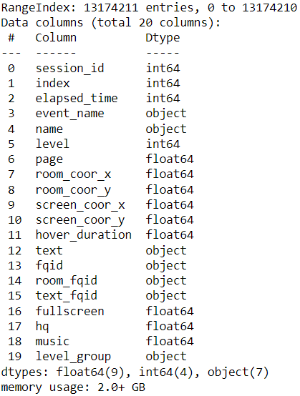
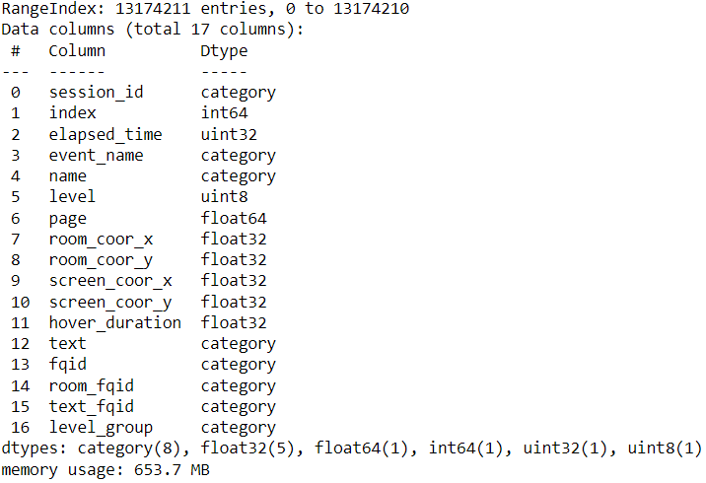
PREPROCESSING: REDUCE MEMORY USAGE
Remove Columns with no useful data
Change variables data type
Notes:
Moving forward with preprocessing, we reduced the memory usage of our data
we removed columns that do not contain any data values
we changed the data types of the remaining variables, reducing the number of bits allocated to each variable.

Slide 13
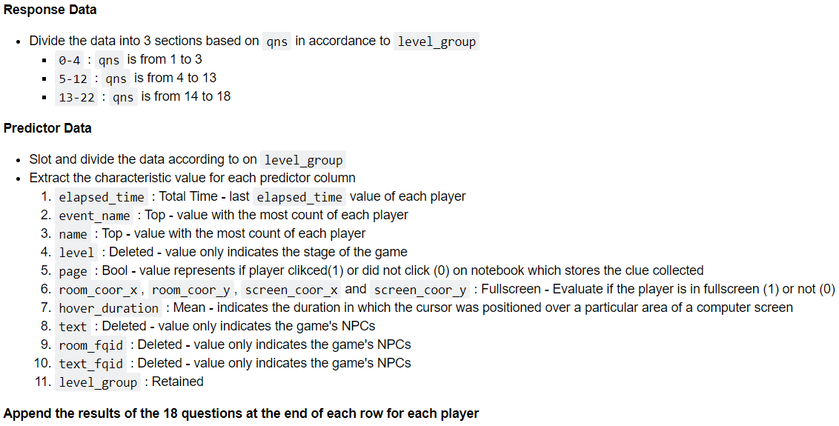
PREPROCESSING: COMBINE BOTH DATA FILES
Notes:
The response & predictor data was divided into 3 sections based on the scenario.
The characteristic values of the predictor's data were extracted as shown.
Notably, at point 1, last elapsed_time values of each player were kept as it provides the full duration of the game play.
At point 6, the room and screen coordinates were utilized to determine if the player was in full-screen mode.
Moreover, Points 4, 8, 9, and 10 were disregarded as they appeared to be technical and not helpful in predicting performance.

Slide 14
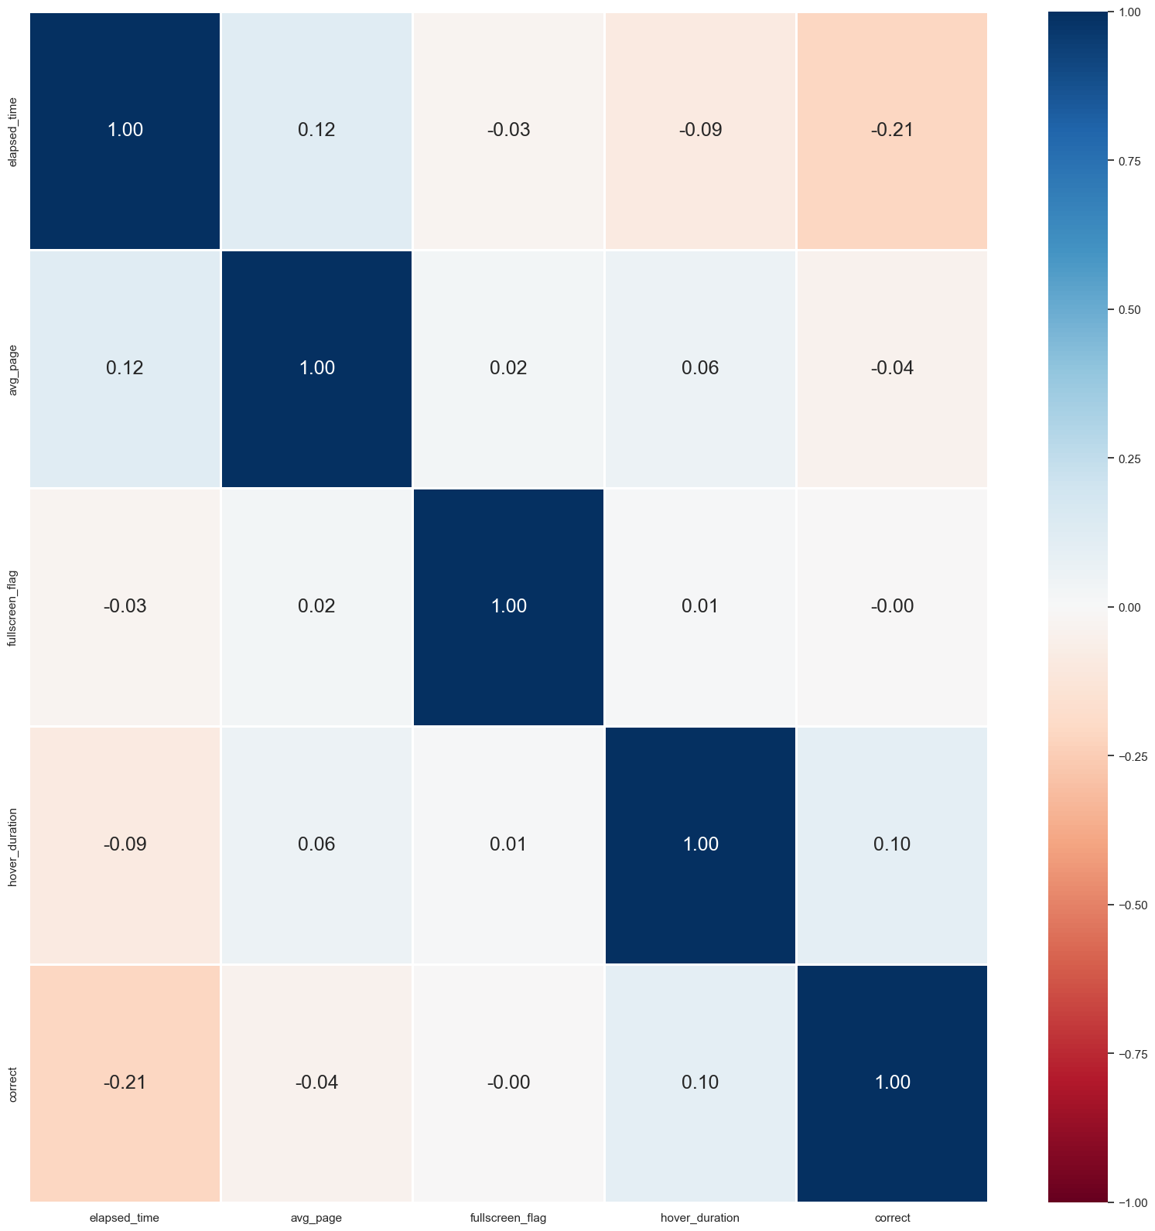
CORRELATION BETWEEN PREDICTORS AND RESPONSE AFTER REMOVING elapsed_time OUTLIERS
Correlation improved
‘elapsed_time’ and ‘hover_duration’ have some relation with ‘correct’
Notes:
After processing the data, we identified and removed outliers from the elapsed_time variable.
By doing so, we were able to focus our analysis on the majority of players and eliminate other potential distraction factors, such as technical issues or player multitasking.
This helped to improve the correlation and highlight that elapsed_time and hover_duration have some relationship with the result outcome.

Slide 15

03
ANALYSIS
Machine Learning Models formulation & analysis
Notes:
Core Analysis
What are the models used?
Why are they used? How does it address the problem?
Provide the formulation / diagram of the model
How are they trained?
Clarify the choice of hyperparameters of the models
Detailed intro of the performance metrics
Briefly introduce the compared baselines
Inference based on the model
Detailed model selection and comparison
Is your model fitting well compared to your baselines?
Which configuration (hyperparameter choices) performs the best?
What numerical results lead to these conclusions? Your conclusion is held in what sense?

Slide 16
MODEL CHOICE
Binary Classification problem
Huge Dataset (over 2.3 GB)
Notes:
There’re two constraints that influence our model selection, first, this is a standard binary classification problem, 2) our dataset is huge.

Slide 17
POSSIBLE MODELS
Decision Tree
Random Forest
XGBoost
Logistic Regression
SVM
Neural Network
Notes:
There’re 6 normal models for binary classification problem:
From EDA, we can see this is apparently not linear relationship between student’s answer and predictors, so we abandon Logistic Regression.
Also since support vector machines and Neural Network is computationally expensive while our dataset is huge. So we exclude them as well.
In all, we will try Decision Tree and two variations of decision tree, Random forest and Extreme Gradient Boosting

Slide 18

BASELINE
Random Guess
0.5
Notes:
For the baseline, As it’s a binary classificaiont problem, probability to choose between correct and wrong will be 0.5

Slide 19
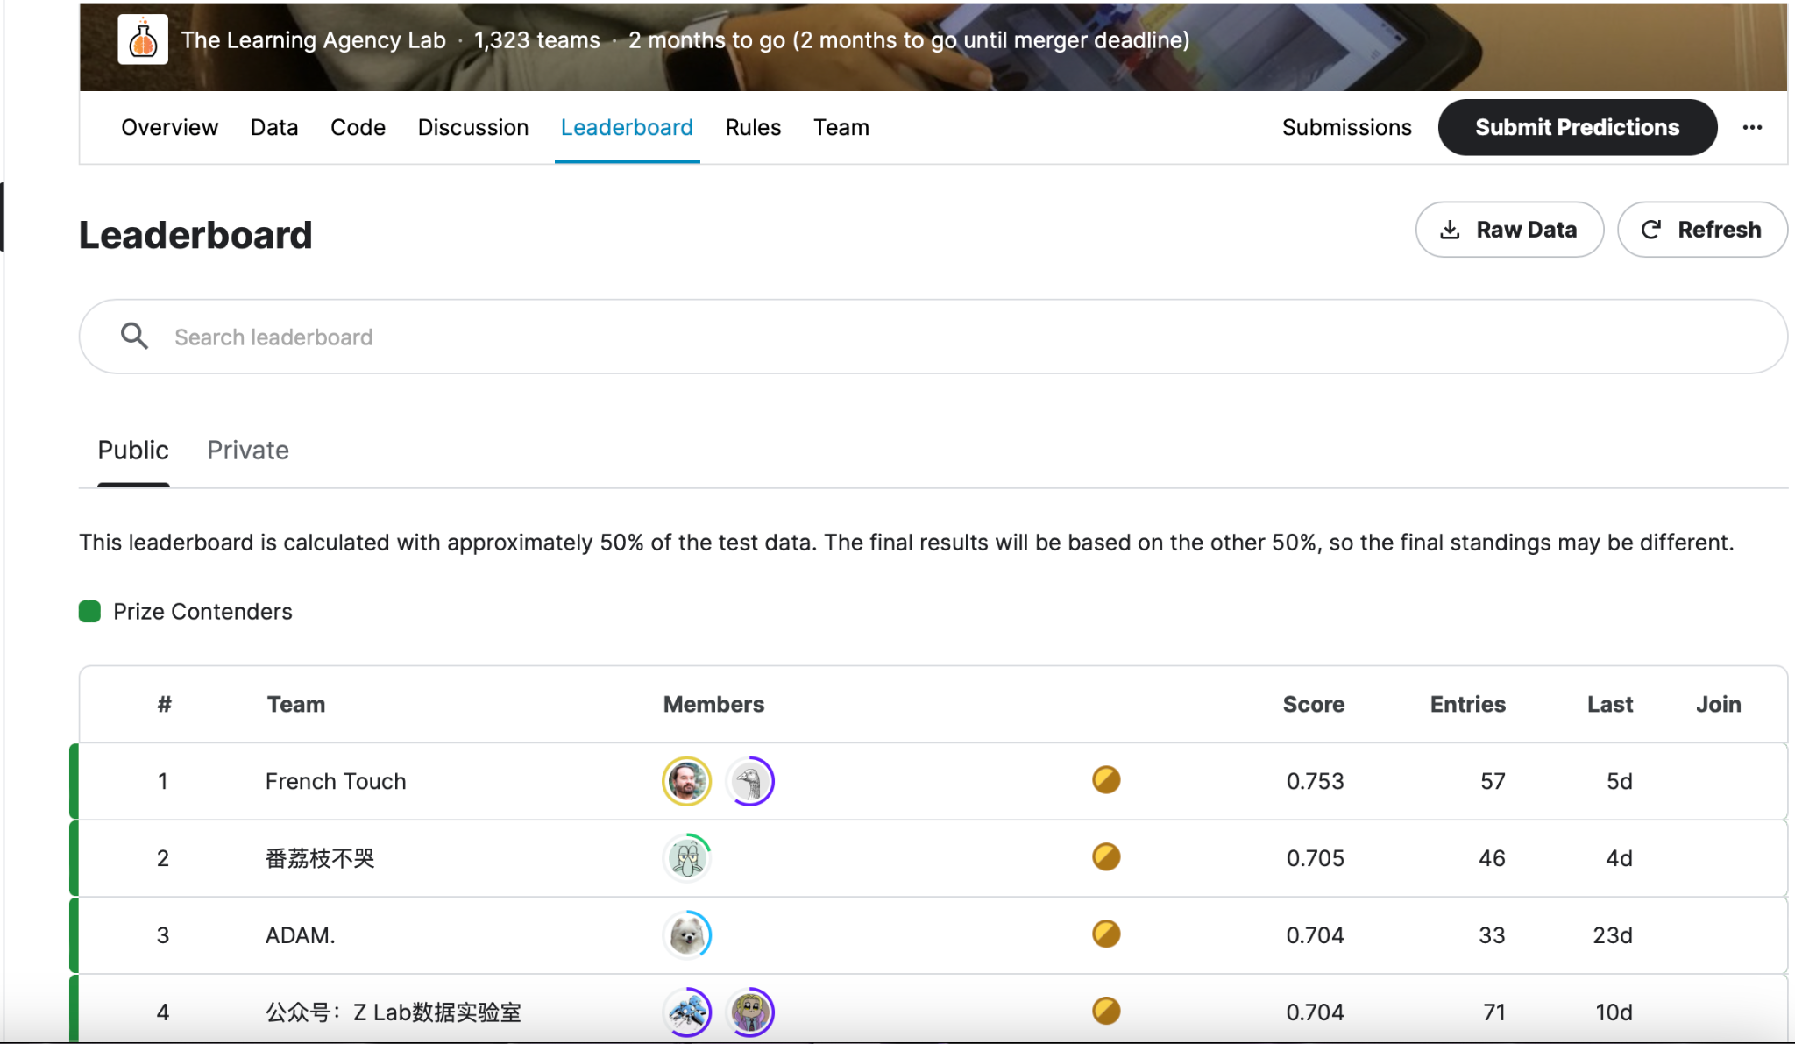
PEAK
Top 3 on Leaderboard
Accuracy:
0.75, 0.705, 0.704
Notes:
The current peak accuracy on Kaggle LEADERBOARD of this competition is 0.75, 0.70, …
So our goal is to try our best to approach 0.7 for our final test data inference.

Slide 20
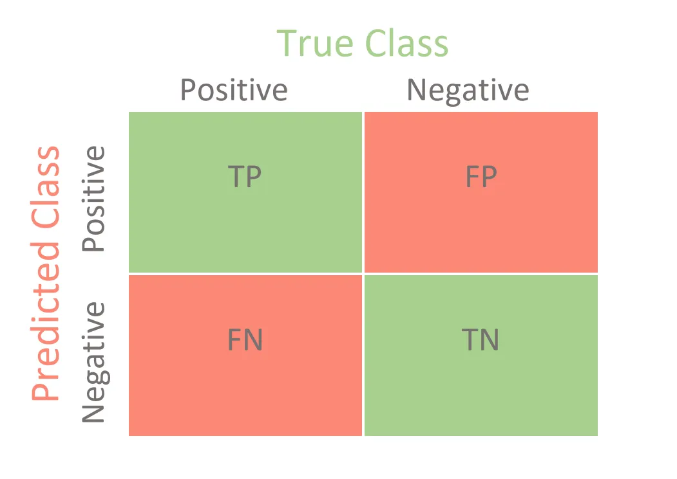
Performance Metrics
Confusion Matrics
Notes:
In the training process, We will be using standard confusion matrics as performance matrics.

Slide 21

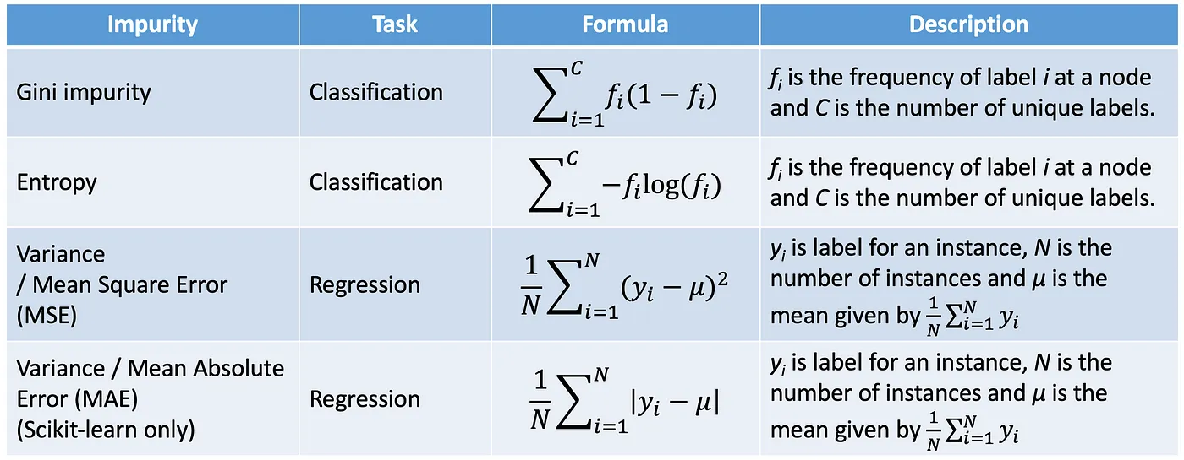
Decision Tree
Notes:
Now it’s time for models: As we learn from lecture, decision tree model recursively splits the data into smaller subsets based on the values of the input features, until the subsets contain only data points of the same class or have reached a certain threshold. So the only main parameter will be max depth

Slide 22
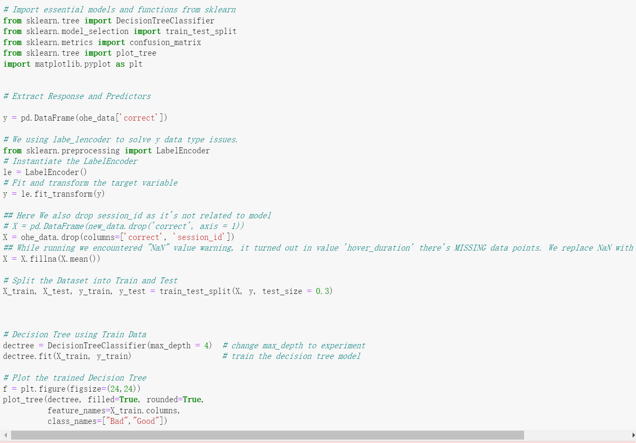
How we trained the model
Split 3:7
Deal with NaN values
Up sampling
Notes:
The procedure is as follows, which is quite standard.
At First we split train data into two parts;
Next we take care of some missing value in hover_duration column by calculating the mean of others.
Last but not least, we did the upsampling for wrong cases, as the wrong cases number turned out to be too limited compared to correst cases

Slide 23
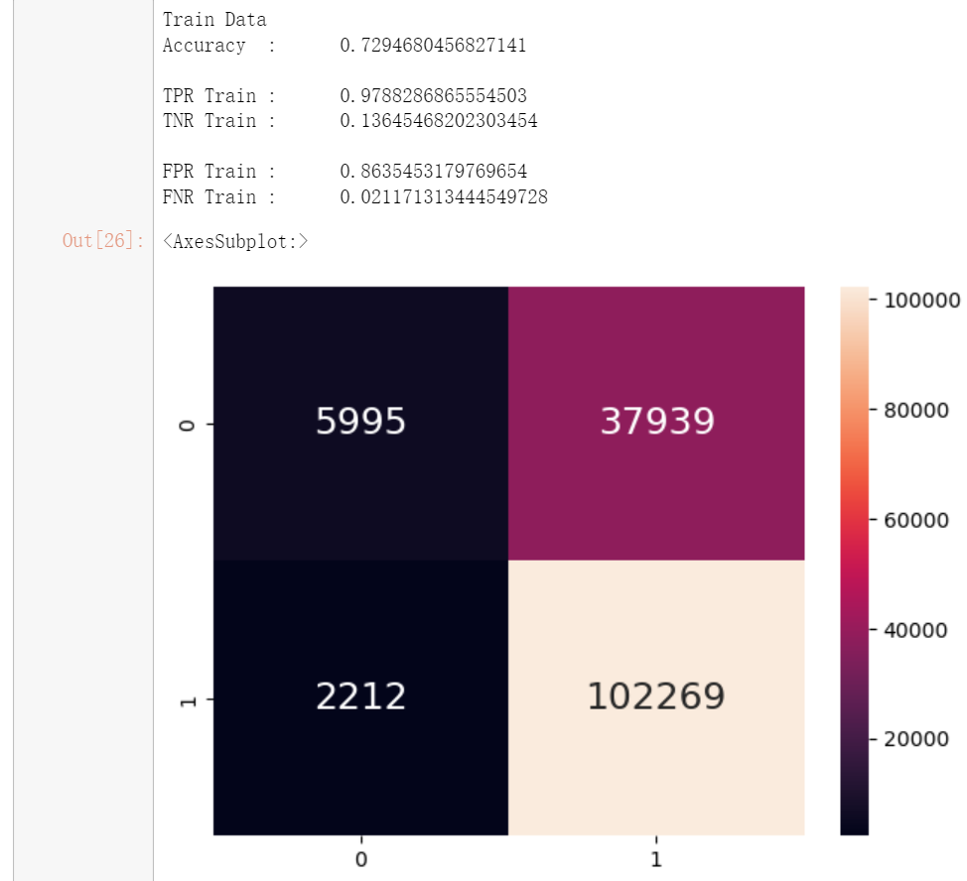
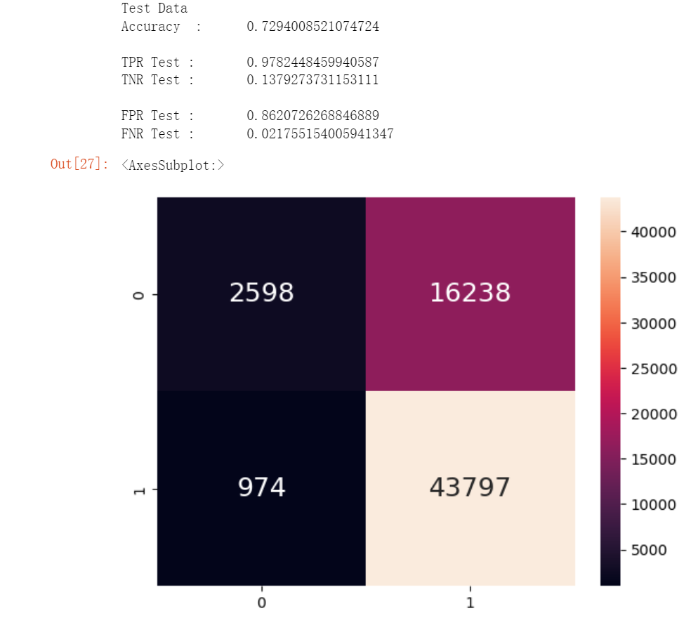
Performance Matrics (original) max_depth=4
Notes:
This is our results, using confusion matrics, original data has accuracy around 0.72 for both train and test data

Slide 24
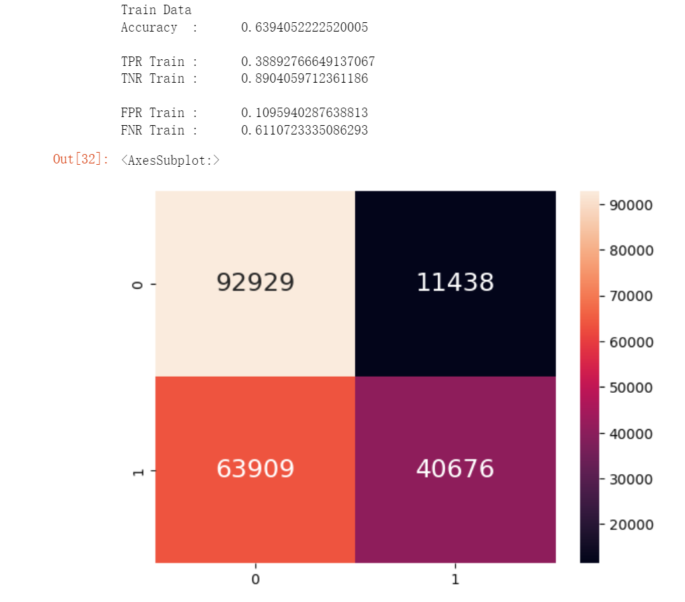
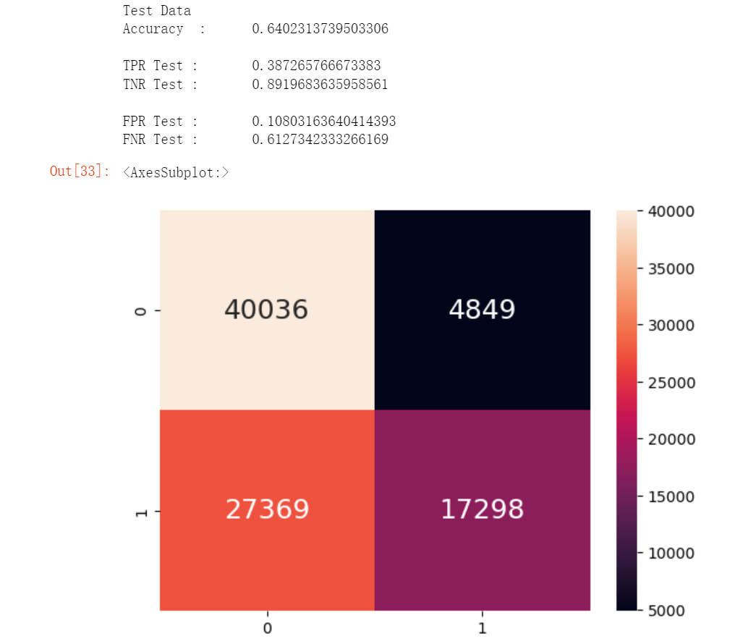
Performance Matrics (upsampled) max_depth=4
Notes:
After upsampling, the accuracy dropped to around 0.64. But it’s OK, We now try Updated version of Decision Tree, random forest, to try to improve the accuracy.

Slide 25

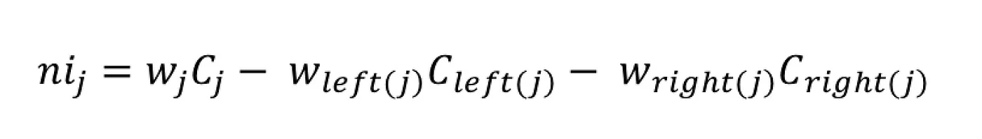
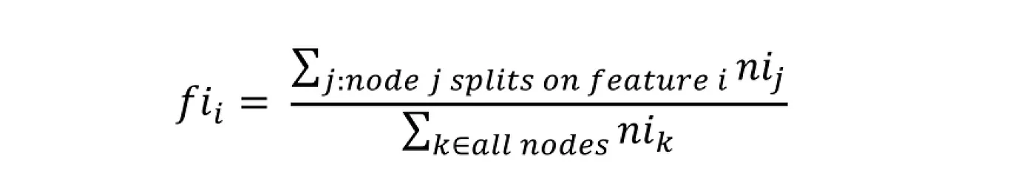


Random Forest
Notes:
random forest is essentially a collection of decision trees.
The individual decision trees in the random forest are built using a subset of the training data and a subset of the input features, which helps to reduce overfitting and improve the generalization ability of the model.
The formulas on slides are procedures to divide into subsets, calculate importance, and sum up the final random forest results.
Again max depth will still be main parameters, also estimators will be another one

Slide 26
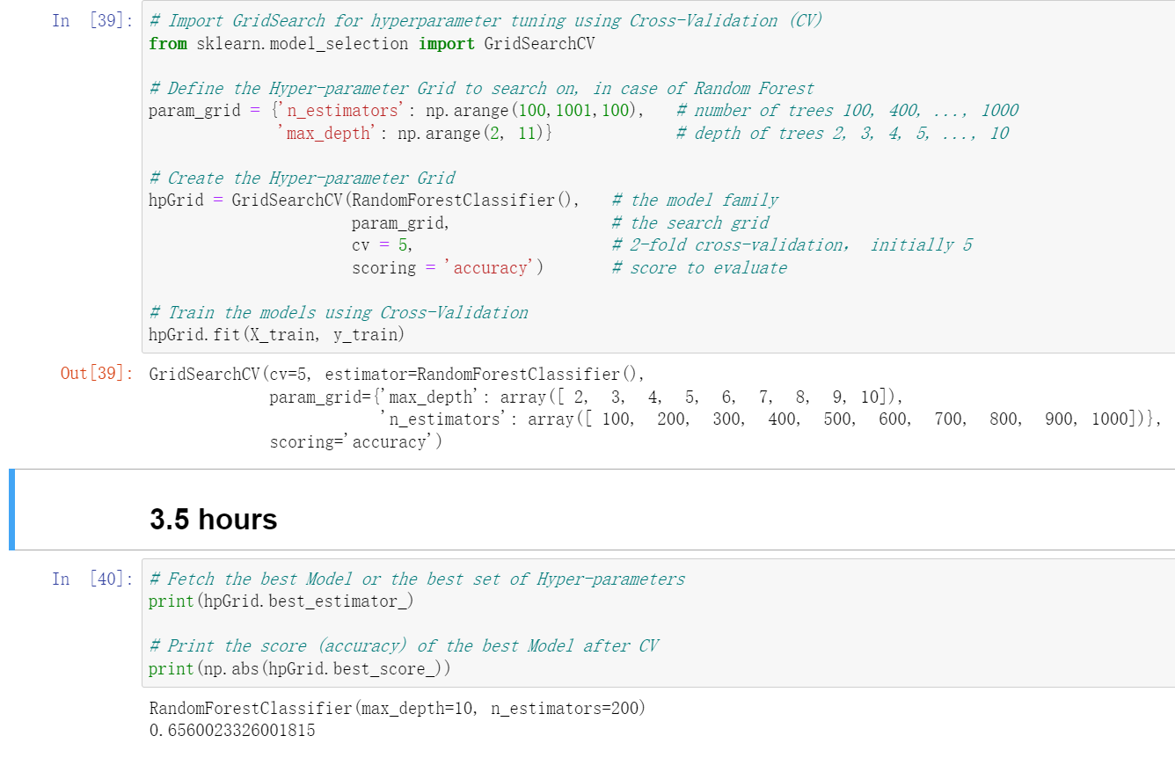
How we trained the model
Using Upsampled data
Cross Validation
Notes:
We will keep using upsampled data we obtained just now, and we applied Cross Validation to measure the optimal performance and their hyperparameters. It took really long to finish CV and we finally obtained the hyperparameters: 200 as estimators and 10 as max depth

Slide 27
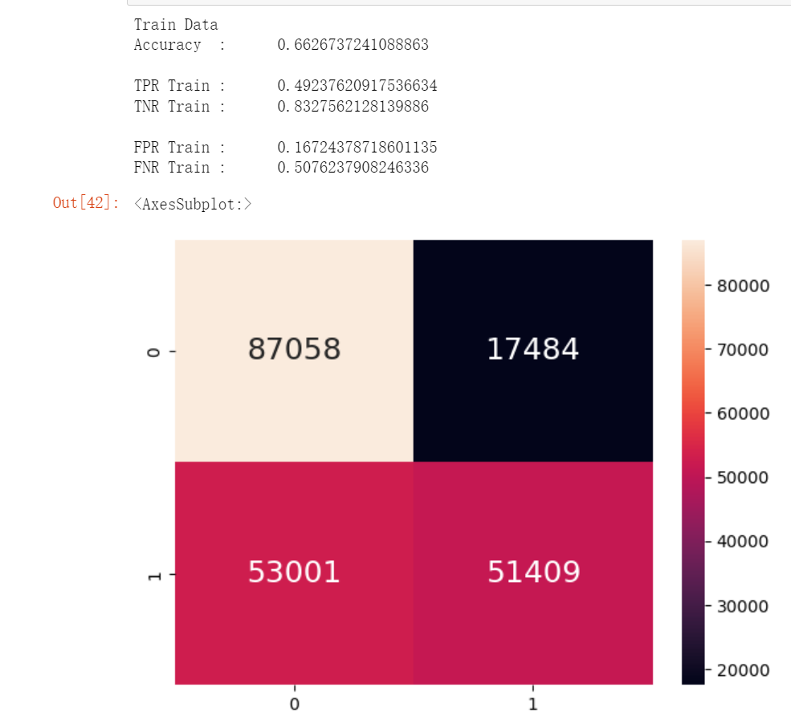
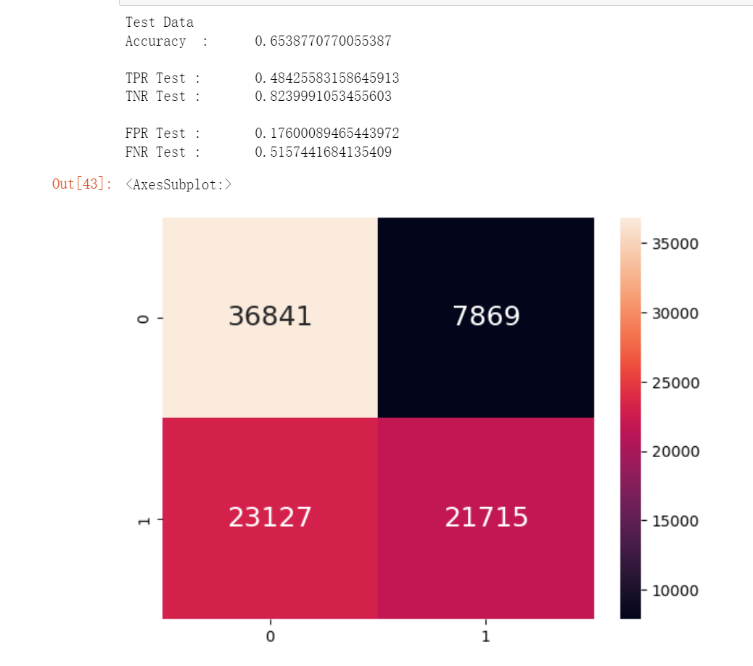
Performance Matrics max_depth=10 n_estimator= 200
Notes:
Again, using confusion matrics, our accuracy turned out to be around 0.66. Next, we try another new model, XGboost

Slide 28

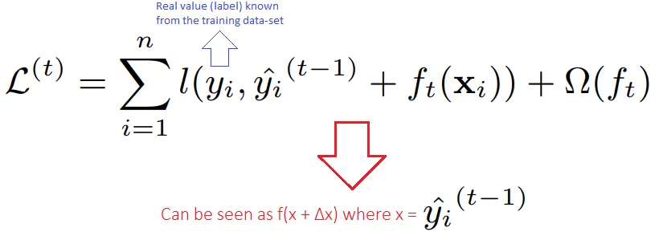
XGBOOST
XGBoost is another variation of is a type of boosting algorithm that combines multiple weak decision trees to create a strong predictor.
The basic idea behind boosting is to combine many weak models to create a strong model that can make accurate predictions.
Notes:
XGBoost is another variation of is a type of boosting algorithm that combines multiple weak decision trees to create a strong predictor. Here is the loss function at iteration t for minimizing the value of the XGBoost.

Slide 29
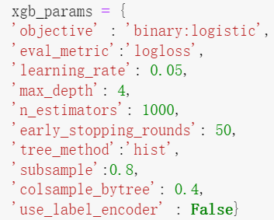
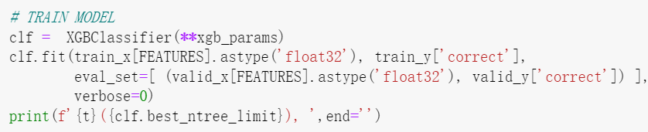
How we trained the model
Using Best-Fit Parameters
Fit the Preprocessed data into the model
Notes:
We selected a set of parameters to train the XGBoost model. learning rate and number of estimators are two variables that affect the performance of the algorithm most. Theoretically, the lower of learning rate and larger of number of estimators will result in better performance. As our experiments, 0.05, and 1000 are the best choice as if we further decrease the learning rate or increase the estimators, the performance won’t be improved but it takes much longer time to train
Then, the second step is to fit the preprocessed data with these parameters in and train the model

Slide 30
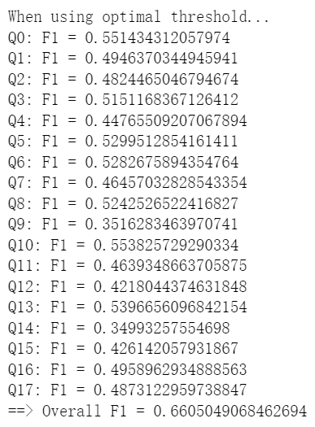
F1_Score Sample_Rate=0.05 n_estimator=1000
Precision = TP / (TP + FP)
Recall = TP / (TP + FN)
F1 score = 2 * (precision * recall) / (precision + recall)
Notes:
The performance of XGBoost can be estimated by F1_score, which is calculated by parameters in the confusion matrix. The best overall F1 score we got is 0.66

Slide 31
CONCLUSION
04
Outcome && Limitation

Slide 32
Results: Inference from test data
Random Forest
XGBoost
0.64
0.67
Notes:
In conclusion, after tentative submission to kaggle with our trained RANDOM FOREST MODEL and XGBOOST MODEL, which fits in the hidden test data provided by Kaggle and obtained the prediction results and compared with the hidden test data, Our accuracy is respectively 0.64 and 0.67. We can say our model is expectedly efficient for this problem.

Slide 33
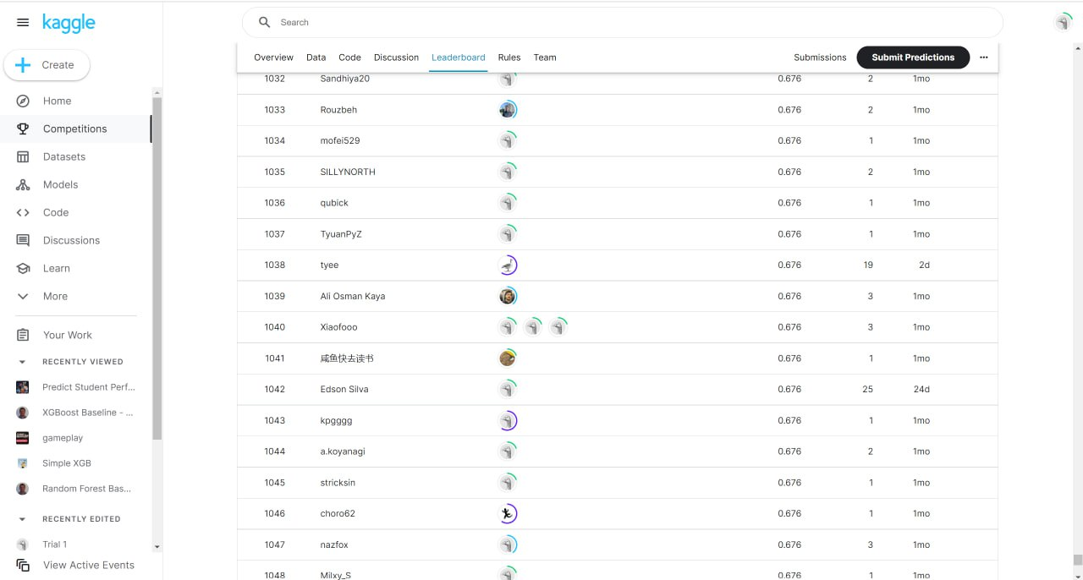
Leaderboard
Notes:
And currently we’re ranking around 1000 in this competition with 0.676 as our best accuracy

Slide 34
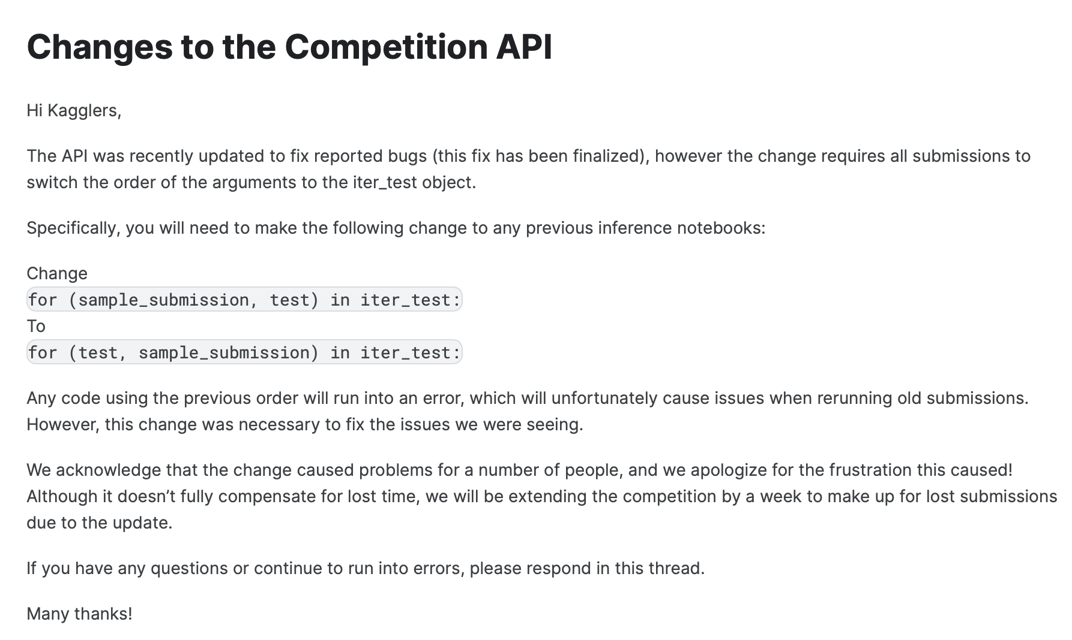
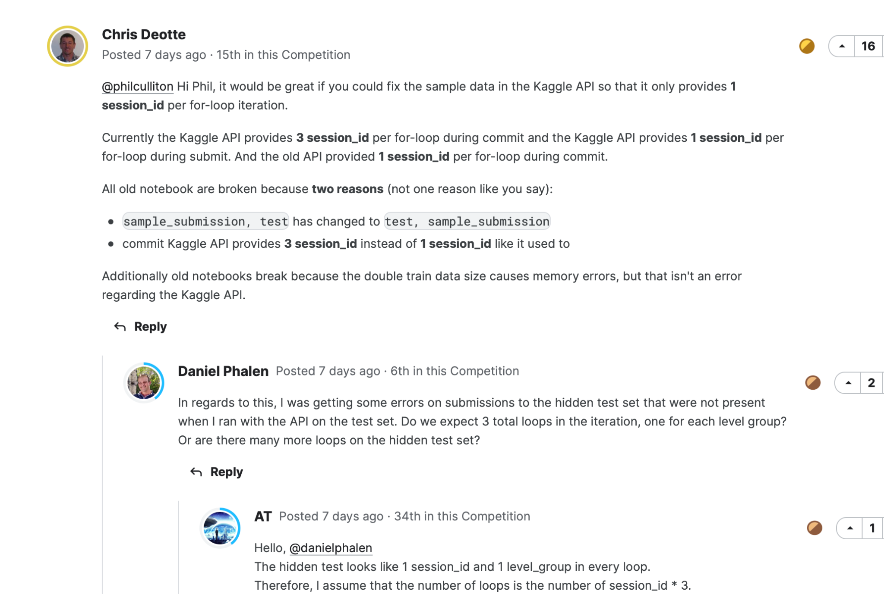
Limitation and Future Work
Notes:
For limitation and future work,
One week ago, Kaggle suddenly changed everything from dataset, test set, submission API and extended the deadline for another 1 month.
Heated discussions have been going on for days as we suddenly found updated API doesn’t support all the old notebooks and no one can currently submit properly.
So our future work will be:
Train our models after final exam, then try our best to climb as high as possible as leaderboard.

Slide 35
RESOURCES
https://www.kaggle.com/code/curiosity30/reduce-memory-2gb-500mb
https://www.kaggle.com/competitions/predict-student-performance-from-game-play/discussion/384534
https://www.kaggle.com/code/cdeotte/xgboost-baseline-0-680
NTULearn SC1015 Exercise 6 Walk-Through Notebook

Slide 36

THANK YOU!
Huang Caihong (U2222629H)
He Haoshen (U2123053D)
Sun Ming Zhong (U2110180J)

